Slide 1
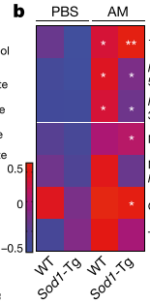
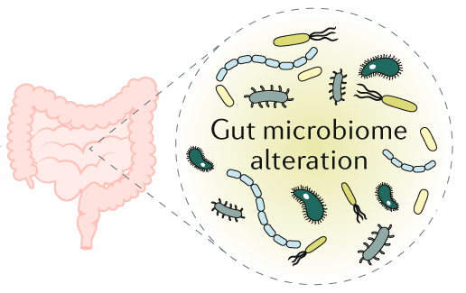
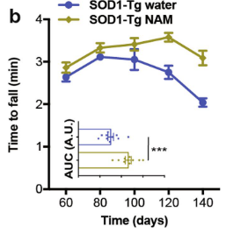
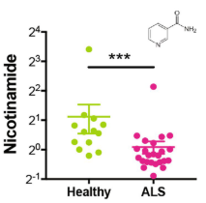
Biomarker and mechanism for potential microbiome-based ALS therapy
Supplementation and probiotic approaches to ameliorate reduced nicotinamide in mice and humans
Metabolomics
Nicotinamide-related
metabolites
Nicotinamide levels
SOD G93A mouse model
Mouse
Human
Humans ± ALS
ALS symptoms
Challenge
Metabolomic Insight
Outcome
New treatment options needed
Amyotrophic lateral sclerosis (ALS) is a complex disease with few treatment options
Alterations in microbiome shown to contribute in an ALS mouse model, but mechanism and biomarkers were lacking from the study
Gut bacteria associated with ALS symptoms modulate NAM
Serum metabolomics revealed increased nicotinamide (NAM) in sera of mice treated with beneficial probiotic (A Muciniphila)
Targeted assay revealed reduced NAM in sera and CSF of both ALS mouse model and humans with ALS compared to controls
Both AM probiotic and NAM supplementation ameliorate ALS progression symptoms in mice
Novel therapeutic avenue
Translatable biomarker (NAM) associated with ALS symptoms IDed
Highlights connection of microbiome, metabolism, & disease
Opens the door to new therapies for ALS based on modulating NAM
Blacher…Segal E & Elinav E. (2019) Nature. 572: 474-484.
Notes:
Challenge
ALS is complex disease with few treatment options except for a small number of glutamatergic inhibitors that inhibit release of glutamic acid from neurons.
Using the sod g93a mouse model of ALS, they showed alterations in the microbiome that likely may play a key role in disease onset and progression (depleted microbes with broad spectrum antibiotics and assessed motor activity)
Experiment
Primary investigators: Eran Elinav and Eran Segal, Weizmann Institute of Science (Rehovot, Israel)
[background]16S data indicated very different microbiome composition in WT vs SOD mice and inoculated abx mice with clonal strains of the biggest changers. One of these Akkermansia mucinophila decreased with severity and inoculation of AM improved motor function (abilities) and improved lifespan. Another set of bacteria (Ruminococcus torques and Parabacteroides distasonis) exacerbate ALS symptoms.
But how are these bacterial ID’s associated with disease phenotype? [Note: study in mice, how would these translate to humans?]
Metabolomics to the rescue
Given the distal nature of gut microbiome to CNS pathophysiology, they looked for soluble mediators, focusing on metabolites stemming from microbial metabolic activity. They identified 84 serum metabolites significantly altered with AM administration and prioritized this by metagenomic index to identify AM-related changes. Several were identified as the highest probability of being produced by a functional (AM) microbiome that is lost in ALS, with nicotinamide (NAM) ranking among the most probable due to enrichment of serum intermediates in NAD biosynthesis [left figure].
Then they proved that AM produced NAM in cultures relative to other control clonal strains using targeted metabolomics and that NAM was increasing in levels of CSF in animals inoculated with AM.
[Important translatability!] In a small cohort comparing human individuals with ALS vs household controls, they found that serum levels [note both global metabolomics and targeted, global serum shown, middle] of NAM were significantly higher in healthy (n=33) vs ALS (n=60), as well as CSF levels of NAM (targeted, right graph; n’s ALS=14, healthy=17)
To prove a causal role for NAM derived from AM inoculation, they dosed animals with subQ mini-osmotic pumps showing higher CSF NAM levels and improved outcomes (right figure = motor function—rotarod locomotor test, improved “time to fail”), including a non-significant increase in lifespan.
Outcomes
Global metabolomics acted as a “compass” for the microbiome data – identifying the affected pathway (NAD+ biosynthesis) and a TRANSLATABLE biomarker (NAM)
Yet another example of the interconnectivity of microbiome-metabolism-disease, how metabolites are the mediators of gut-brain axis effects, and how metabolites are translatable to humans once discovered in an animal model.
These clues open the door to new therapies for ALS (via affecting NAD pathway…Elysium Health supplement nicotinamide ribonucleotide shown to improve ALS in early clinical trial)
Author’s quote in abstract: “We suggest that environmentally driven microbiome-brain interactions may modulate ALS in mice, and we call for similar investigations in the human form of the disease.”

